Slide 1
Economics
Week #4

Slide 2
Topics of Week #4
Elasticity
Price Elasticity of Demand*
Elasticity Formula*
Income Elasticity*
Cross-Price Elasticity
Price Elasticity of Supply
Case Study
"*" Indicates the most important topics.
Mateer and Coppock: Chapter #4

Slide 3

Elasticity
Elasticity
Responsiveness of buyers and sellers to changes in market conditions.

Slide 4
Price Elasticity of Demand
Recall the law of demand
Demand curve is downward-sloping.
This gives us the direction of the relationship between these two variables.
Price elasticity of demand
A measure of the responsiveness of quantity demanded to a change in price
This gives us the sensitivity of the relationship between these two variables.
Notes:
The law of demand states that there is an inverse relationship between price and quantity demanded. The two variables move in opposite directions (one increases, the other decreases).
This inverse relationship between these two variables occurs as we "slide" along a demand curve.
Elasticity extends and strengthens our knowledge of demand. Mathematically, you could state that we previously knew the SIGN of the coefficient on our variables, now we are studying the MAGNITUDE of the coefficient on our variables.

Slide 5
Computing the Price Elasticity of Demand
Elasticity can help answer questions such as:
Should a firm raise or lower the price of a good to increase revenues?
Total Revenue: P*Q ➔ Law of demand tells if the price increase (decreases) then the quantity demanded decreases (increases). So, without the knowledge of the responsiveness of the demand curve with respect to price, you cannot tell whether the total revenue increases or decreases. That is why the economists care about elasticity (responsiveness).

Slide 6
The Price Elasticity of Demand Formula
∆ = change
Notes:
Ed = Price elasticity of demand
The triangle is the Greek letter "delta," which is mathematically used to denote changes in a variable. If your students have taken calculus, they will recognize the symbol. But be careful mentioning this. This formula is NOT a derivative. It is a ratio of percentage changes. Later, we'll see that even a linear demand function will have different elasticity values along the line.

Slide 7
Example
University parking pass prices increase by 50%.
As a result, 25% less people demand a parking pass.
Plug in numbers
Notes:
Click to show the plugged-in numbers. We are plugging in the numbers to get our elasticity value. In this case, the division is pretty simple.

Slide 8
Price Elasticity of Demand
Demand is elastic if
Quantity demanded changes significantly as the result of the price change.
Elastic = "sensitive" or "responsive."
Demand is inelastic if
Quantity demanded changes a small amount as the result of the price change.
Inelastic = "insensitive" or "unresponsive."
Notes:
Prices can and do change. When the price of a good increases, sometimes we buy a little bit less. For other goods, if the price increases, we may buy a lot less.
See the rubber band. When we think of "elastic," we may think of something that can be stretched. A new or tight rubber band can be thought of as very elastic, and will be responsive when you try to stretch or pull it. An old rubber band that has lost its elasticity (perhaps it is inelastic) won't be responsive.

Slide 9
Example
What does the numerical result mean?
In this case, the quantity demanded response was relatively small (compared to the price change).
Demand is inelastic for parking.
Why is it negative?
There is an inverse relationship between price and quantity demanded.
Notes:
Note that elasticity is UNITLESS. The prices cancel out. The Qd terms cancel out. The percentage changes cancel out. We are just left with a number. What does the number mean? It's a measure of sensitivity. A BIG negative number means MORE sensitivity. A SMALL negative number means LESS sensitivity.

Slide 10

Midpoint Method
One issue with using the percent change formula.
Price decreases from $100 to $80
A 20% change
Price increases from $80 to $100
A 25% change!
Thus, the "direction" of the variable change will change our numerical elasticity result. How can we fix this?
Notes:
With price elasticity of demand, we often estimate elasticity over a range on the demand function. Thus, we'll have two reference points (and 'old' point and a 'new' point). If we switch the 'old' and 'new' point, we'll get different estimates of elasticity as a result of different percent changes as shown in the slide.
The percent change formula by itself is:
new – old
percent change = ------------
old

Slide 11
Midpoint Method
The Midpoint Method is an alternative way to find elasticity. The formula is more complicated.

Slide 12
Midpoint Method
Example:
"Old" price. P₁ = $6 results in Q₁ = 15
"New" price. P₂ = $4 results in Q₂ = 25
Plug in numbers

Slide 13

Price Elasticity of Demand
SNAPSHOT
-1
Inelastic product or service
Elastic product or service
Not highly responsive to a price change and has an elasticity value between 0 and –1.
Highly responsive to a price change and has an elasticity value less than –1.
INELASTIC
ELASTIC
Notes:
Determining the price elasticity of demand for a product or service involves calculating the responsiveness of quantity demanded to a change in the price. The chart below gives the actual price elasticity of demand for ten common products and services. Remember, the number is always negative because of the inverse relationship between price and the quantity demanded. Why is price elasticity of demand important? It reveals consumer behavior and allows for better pricing strategies by businesses.
REVIEW QUESTIONS
Why is demand for coffee relatively inelastic?
For business owners, why is it important to understand whether demand for their products is elastic or inelastic?

Slide 14
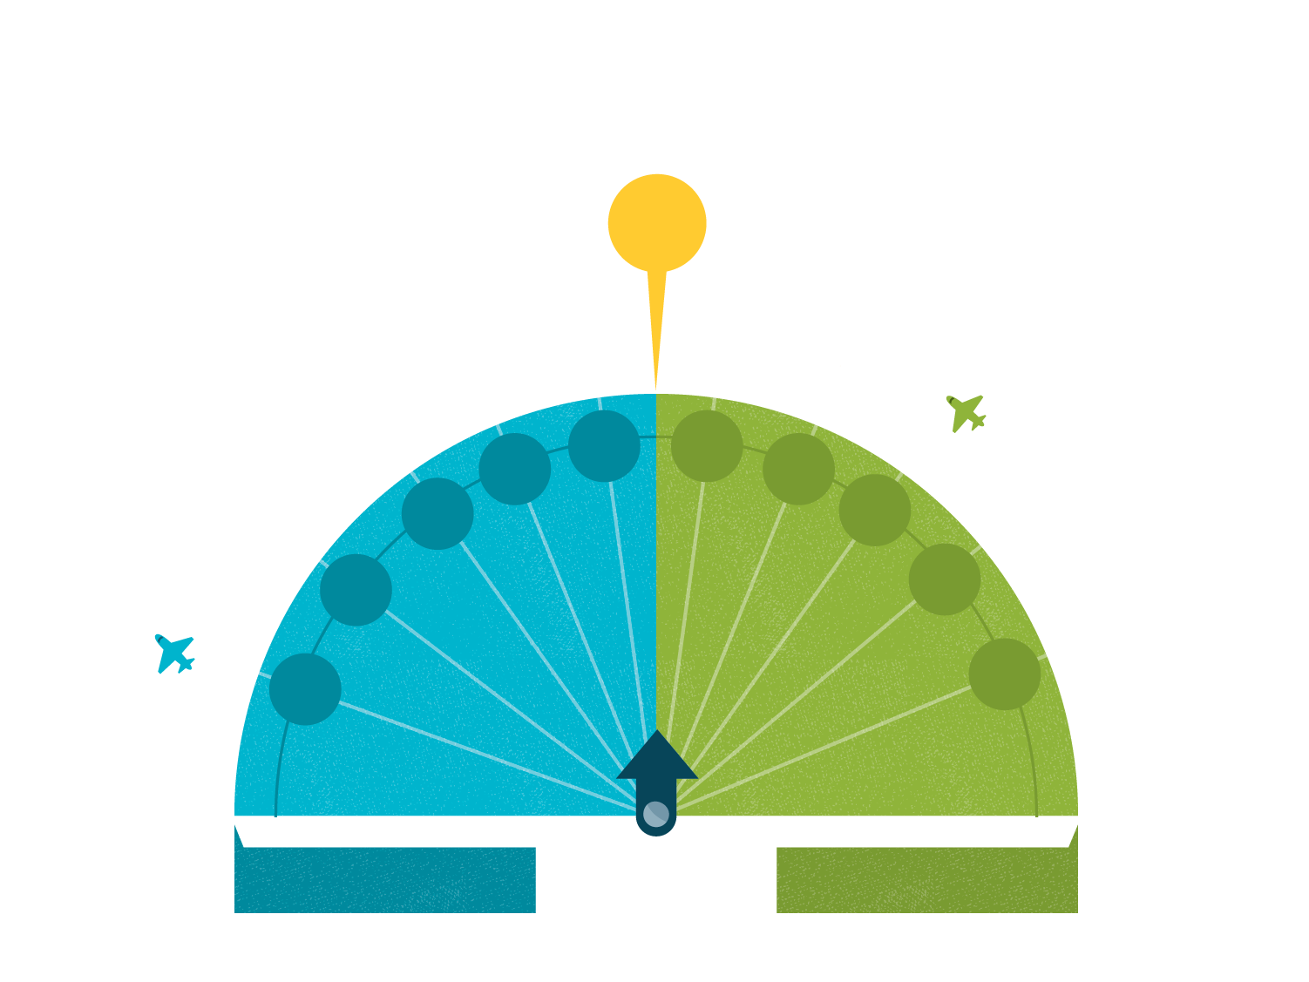
Price Elasticity of Demand
SNAPSHOT
-1
Private education
Tobacco products
Movies
Restaurant meals
Coffee
Airline travel
-.9
-1.1
-.45
-1.6
Medical care
-.25
- 2.4
Fresh vegetables
-.17
- 3.7
Airline travel
Honda automobiles
-.1
- 4
INELASTIC
ELASTIC
Notes:
Determining the price elasticity of demand for a product or service involves calculating the responsiveness of quantity demanded to a change in the price. The chart below gives the actual price elasticity of demand for ten common products and services. Remember, the number is always negative because of the inverse relationship between price and the quantity demanded. Why is price elasticity of demand important? It reveals consumer behavior and allows for better pricing strategies by businesses.
REVIEW QUESTIONS
Why is demand for coffee relatively inelastic?
For business owners, why is it important to understand whether demand for their products is elastic or inelastic?

Slide 15
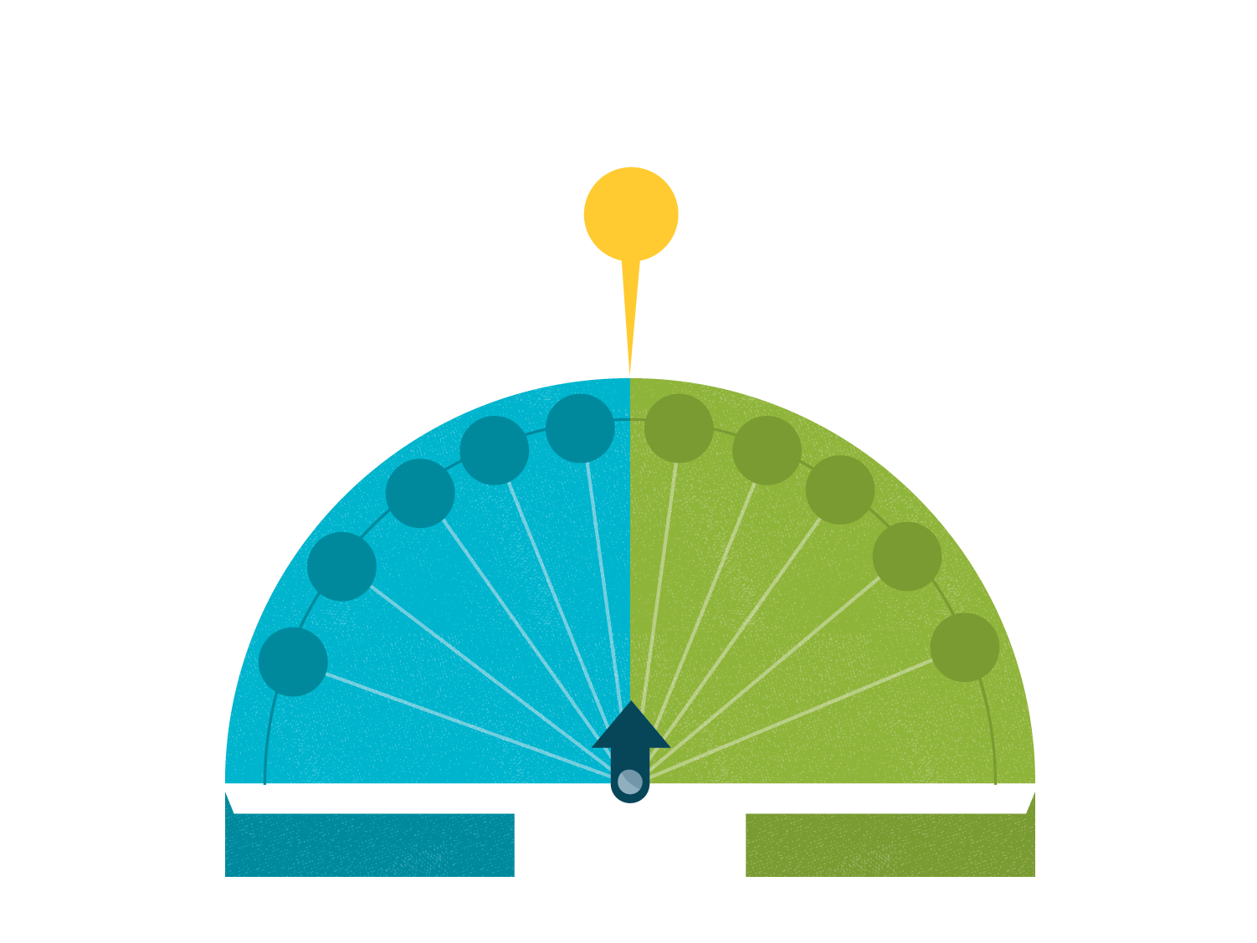

Price Elasticity of Demand
SNAPSHOT
-1
Elastic
airline travel
Includes travel for pleasure
Inelastic airline
travel
Includes business travel and travel for an emergency
- 2.4
-.1
INELASTIC
ELASTIC
Notes:
Determining the price elasticity of demand for a product or service involves calculating the responsiveness of quantity demanded to a change in the price. The chart below gives the actual price elasticity of demand for ten common products and services. Remember, the number is always negative because of the inverse relationship between price and the quantity demanded. Why is price elasticity of demand important? It reveals consumer behavior and allows for better pricing strategies by businesses.
REVIEW QUESTIONS
Why is demand for coffee relatively inelastic?
For business owners, why is it important to understand whether demand for their products is elastic or inelastic?

Slide 16
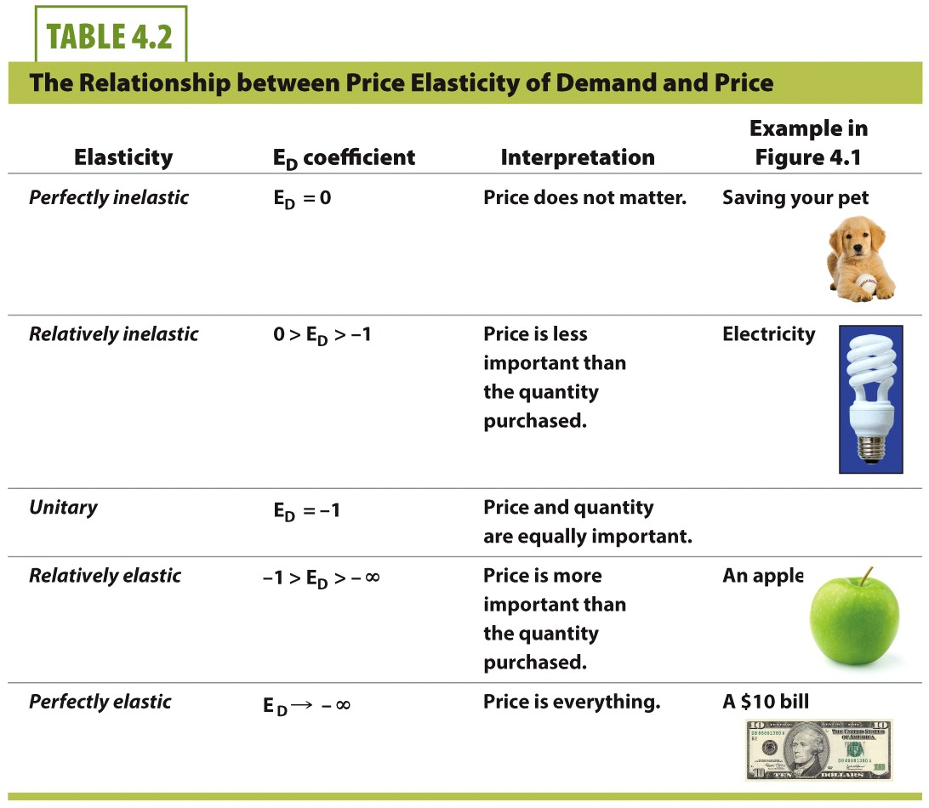

Slide 17
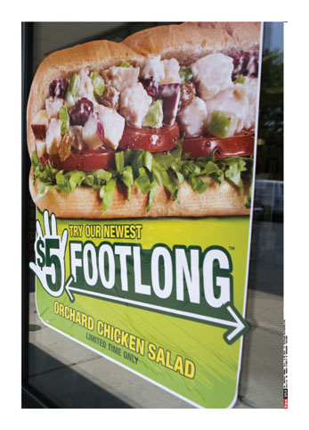

The Determinants of the Price Elasticity of Demand
Existence of substitutes
Goods with lots of substitutes
Canned vegetables, breakfast cereals, many types of products with multiple brands
More elastic
Goods with no good substitutes
Broadway theatre, rare coins, autographs, drinking water, electricity, and Super Bowl tickets
More inelastic
Notes:
Determinants: What determines whether demand is elastic or inelastic?
Goods with lots of substitutes:
For brand name products, I like to use toiletries (toothpaste, deodorant, shampoo) as examples. Also, breakfast cereals have a lot of brand-name substitutes.
One type of fruit or vegetable can substitute for another kind. No apples today? I'll get a banana or orange instead.
The price change intuition follows closely. Unless you are extremely brand loyal, an increase in the price of your shampoo may cause you to buy another substitute brand.
Goods with no good substitutes:
Can't replace drinking water or electricity; only one Super Bowl, accept no substitutes!
With a price increase in electricity, we don't turn our air conditioning off. We may make SMALL changes, but nothing drastic.

Slide 18
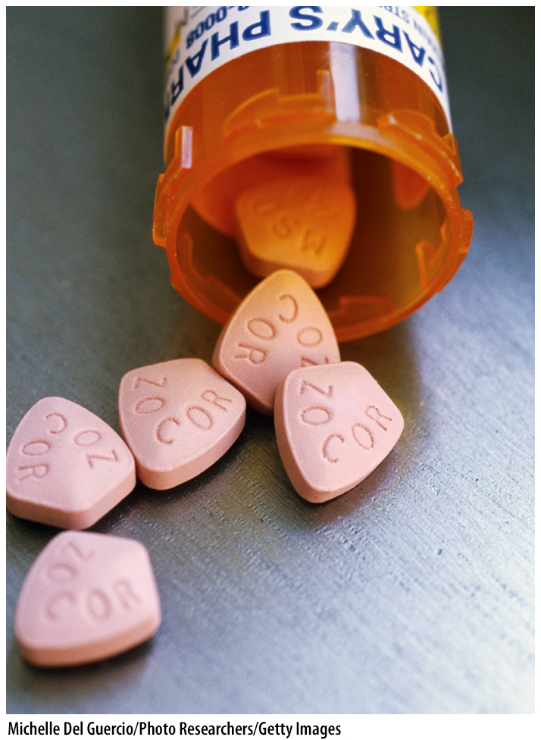

The Determinants of the Price Elasticity of Demand
Necessities versus luxuries
Affects the options the consumer faces
Luxuries ➔ Elastic
Necessities ➔ Inelastic
Notes:
Lecture notes:
When the price of a good rises, the consumer will typically want to buy less.
Ask students to suggest some "necessities" in their lives.
Some possible "necessities" include:
Electricity
Internet
Gasoline
Mobile phone service
Clean water
Medication
Toilet paper
Now, ask them to list true "luxuries."
Some possible "luxuries" include:
Vacations
Dining out
Jewelry
Designer clothes
Imported beers
Follow up by asking them to consider how they would respond to a 10 percent change in the price of each.
For which goods will they alter their purchases by the largest amount?
[pills: Michelle Del Guercio / Photo Researchers / Getty Images/; ring: © Ragoarts | Dreamstime.com]

Slide 19

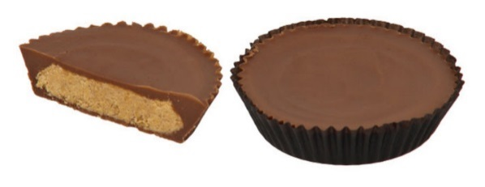
The Determinants of the Price Elasticity of Demand
Share of the budget spent on the good
Demand is more elastic for "big ticket" items that make up a large portion of income.
Demand is more inelastic for inexpensive items.
Which would you react to more?
20% sale on a new vehicle you want
20% sale on candy bar
Notes:
Thinking about buying a new car? A 20% sale could greatly influence your decision to buy that vehicle (as opposed to another vehicle that is not on sale). You may call home to mom to brag about 20% savings on a car, but you won't call to tell her you saved 20% on a candy bar.
Also, if you visited a car dealer with the intent of buying a car, and found out that car was 50% more expensive than you thought, you would most likely not buy the car. On the other hand, if you wanted to buy a candy bar and found out it was 50% more expensive than you thought, this would probably not deter you from buying your favorite candy bar.

Slide 20

The Determinants of the Price Elasticity of Demand
Whether the market is broadly or narrowly defined
Affects the options the consumer faces
Narrowly defined ➔ Elastic
Broadly defined ➔ Inelastic
Notes:
Lecture notes:
Examples of broadly defined:
Ice cream
Breakfast cereal
Cars
TVs
Examples of narrowly defined:
Breyer's French vanilla ice cream
Kellogg's Frosted Flakes
Toyota RAV4
Sanyo 46" Smart TV
Ask students if they can come up with an explanation for why the demand for a specific brand of a good will be more price elastic.
[© Cobalt88 | Dreamstime.com]

Slide 21
The Determinants of the Price Elasticity of Demand
Time and adjustment process
Generally, demand for goods tends to become more elastic over time.
Over time, consumers are
More able to find substitutes.
More able to adjust for price changes in other ways.
Notes:
"Other ways" could include changing your behavior or situation in a more drastic way beyond just consuming less of the good or consuming a substitute good. In a couple of slides, we will see that one way to consume less gas is to move closer to where you work (this may occur since there is not currently many viable gasoline substitutes to power vehicles). This will decrease gas consumption.

Slide 22
Economics in Jingle All the Way
"Jingle All the Way"
Use the determinants of elasticity.
Which good has the more relatively inelastic demand? Turbo Man or Booster?
Notes:
"Economics in the Media"
Lecture Tip:
The clip mentioned on the slide can be found in the Interactive Instructor's Guide. Access the direct link by clicking the icon in the PowerPoint above.

Slide 23
Graphing Price Elasticity
If demand is relatively elastic
We are relatively sensitive to price changes.
The demand curve is relatively flatter.
If demand is relatively inelastic
We are relatively insensitive to price changes.
The demand curve is relatively steeper.

Slide 24
Graphing Price Elasticity
Denominator is zero!
Notes:
Here, we are infinitely sensitive to price. If the price rises even by 1%, we will buy none of the good. If the price drops by 1%, we will want to purchase as much as we can of the good. Thus, the price cannot deviate from the height of the horizontal line. Mathematically, this will be dividing by zero, which in the limit approaches negative infinity.
Examples include a $10.00 bill. (It must be sold at a price of $10.00). To some extent, we could also consider goods with perfect substitutes. No one will purchase gas for $3.00 if it is being sold at the station next door for $2.95. However, we still have a finite demand for gasoline.

Slide 25
Graphing Price Elasticity
Notes:
Examples of relatively elastic goods fruits, vegetables, and breakfast cereals. There are a lot of substitutes for these goods, but the substitutes may not be perfect, and there may be preferences for one fruit over another. However, the availability of substitutes (whether they are perfect or not) increases our sensitivity to the price of a good.
Emphasize the word "relatively" when you say relatively elastic. Technically, we cannot call this an elastic demand curve, since there is actually an elastic and inelastic section on the line. It is, however, "relatively" more elastic than a curve that is steeper.

Slide 26
Graphing Price Elasticity
Notes:
Examples of relatively inelastic goods include gasoline and cigarettes. When the price of gas goes up, people do not change their driving habits very much. With smoking, higher prices (usually in the form of sin taxes) are accompanied by only small decreases in smoking. This actually results in large revenues from cigarette taxes.
Emphasize the word "relatively" when you say relatively inelastic. Technically, we cannot call this an inelastic demand curve, since there is actually an elastic and inelastic section on the line. It is, however, "relatively" more inelastic than a curve that is shallower.

Slide 27
Graphing Price Elasticity
Numerator is zero!
Notes:
If a good is perfectly inelastic, it means you are willing to pay anything to receive the good or service.
Examples:
Insulin (if you are diabetic)
Health care for your beloved pet

Slide 28
Remembering Elasticity
Relatively shallow (flat) demand curves are relatively more elastic.
Relatively steep demand curves are relatively more inelastic.
Ways to remember:
Steep demand curve looks like the letter "I," so it is "I"nelastic.
Steep demand curve has an almost "I"nfinite slope, and is "I"nelastic
Notes:
In the textbook, another way is shown.
A capital E has three horizontal lines, showing that elastic demand is relatively flat or horizontally sloped.

Slide 29
Time, Elasticity, and Demand Curve
Notes:
We've already discussed immediate run, short run, and long run, and the responsiveness to price changes in each time period. Here, we can see the idea graphically.
In each case, the price rises from P1 to P2.
Immediate run: No change in quantity demanded. Q_{d} remains at Q1; no time to adjust at all.
Short run: Time for a small adjustment. Q_{d} falls to Q2; a slight decrease.
Long run: Time for full adjustment. Demand is more elastic, and Q_{d} falls to Q3; the largest decrease is due to more responsiveness with a relatively more elastic long-run demand curve.

Slide 30
Slope and Elasticity
Elasticity and the slope of the demand curve are related, but are NOT the same.
In fact, with a linear demand curve:
The slope will be the same at all points.
Elasticity will be different at all points.
Elasticity decreases (gets more inelastic) as we move down and right along a linear demand curve.
Notes:
The downward-sloping demand gives the elasticity coefficient the negative sign. However, the slope is not the same as the elasticity.

Slide 31
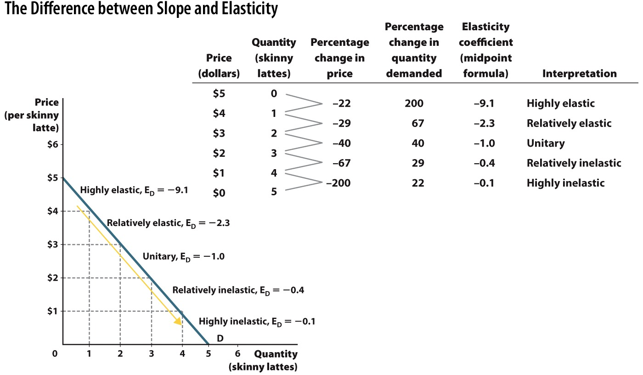
Notes:
Along any straight demand curve, the price elasticity of demand (E_{D}) is not constant. You can see this by noting how the price elasticity of demand changes from highly elastic near the top of the demand curve to highly inelastic near the bottom of the curve.

Slide 32

Price Elasticity of Demand and Total Revenues
Demand elasticity changes along a linear demand function. Who cares?
Elasticity is related to total revenues.
Firms are interested in increasing total revenues.
Firms will need to know whether to increase or decrease price to increase revenues.
Total revenues = Price × Quantity Purchased
Graphically, this is a rectangle connecting the origin and a point on the demand curve.
Notes:
Lecture notes:
In future chapters, we'll talk about profit maximization. When is revenue maximization useful?

Slide 33
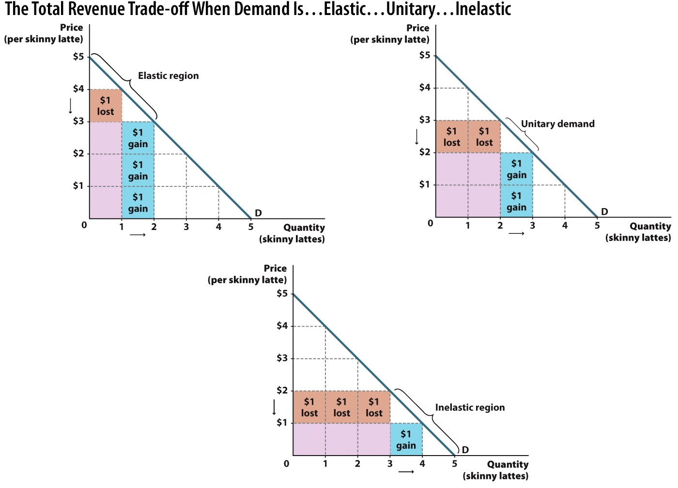
Notes:
(a) The Total Revenue Trade-off When Demand Is Elastic In the elastic region of the demand curve, lowering the price will increase total revenue. The gains from increased purchases, shown in the blue-shaded area, are greater than the losses from a lower purchase price, shown in the red-shaded area.
(b) . . . When Demand Is Unitary When demand is unitary, lowering the price will no longer increase total revenue. The gains from increased purchases, shown in the blue-shaded area, are equal to the losses from a lower purchase price, shown in the red-shaded area.
(c) . . . When Demand Is Inelastic In the inelastic region of the demand curve, lowering the price will decrease total revenue. The gains from increased purchases, shown in the blue-shaded area, are smaller than the losses from a lower purchase price, shown in the red-shaded area.

Slide 34
Income Elasticity
Changes in price
Cause a movement along a demand curve.
Affect your consumption of a good.
Changes in income
Shift the demand curve.
Also affects your consumption of a good.
Income elasticity
Responsiveness of the change in quantity purchased as a result of a change in income.
Notes:
Lecture notes:
Price is not the only variable that determines how much of a good we buy. Other factors, such as income determine our consumption as well.
A different type of elasticity (with different variables now) is income elasticity. Now, we ask how sensitive our consumption is with regard to a change in INCOME.

Slide 35
Income Elasticity
Is this ratio positive or negative?
Income elasticity could be positive or negative, depending on the good.
If income elasticity is positive, there is also interest in whether it is a big or small positive number.
Notes:
Notice that the equation is very similar to the one we've seen before. The numerator is the same, but the denominator is different. We are looking at a change in income instead of a change in price, but we are still examining the effect on quantity demanded.
Note that we are holding price CONSTANT here. How much more (or less) do you buy when income changes, all other things equal?

Slide 36
Income Elasticity
Normal goods
Goods we purchase more of when income rises
Inferior goods
Goods we purchase less of when income rises
Normal goods fall into two categories:
Luxuries
Purchase a lot more when income rises.
Necessities
Purchase a little more when income rises.
Notes:
Normal and inferior should be review. Luxuries and necessities should be new.
Remind students to look at these goods with regard to the numerical income elasticity rather than by thinking about connotation about what they think a necessity or luxury is.

Slide 37
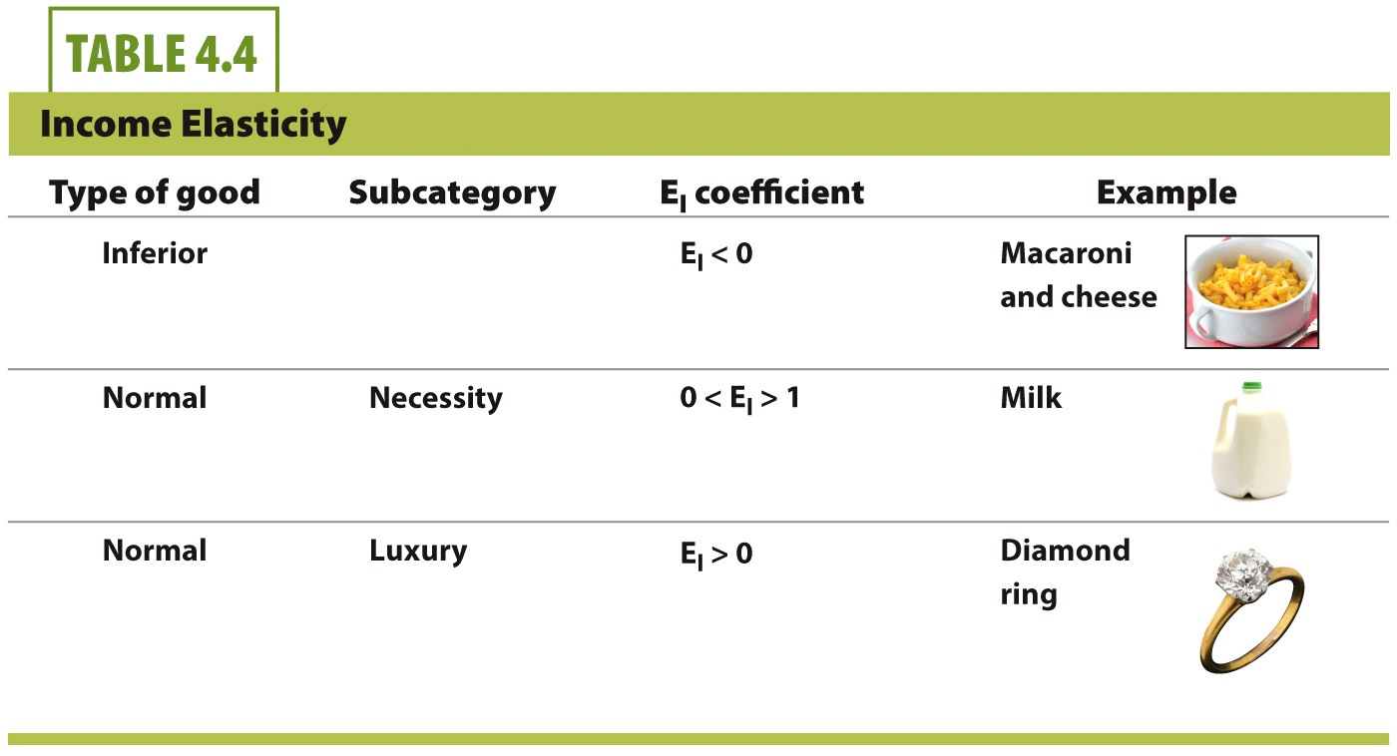
<1
1

Slide 38

Practice What You Know Categorizing Goods
Steak
Toothpaste
Fast food
Pedicures
New vehicles
Used vehicles
Laptop computers
Lawn-care service
Milk
Gasoline
Cigarettes
Lottery tickets
Notes:
Fast food may be considered a luxury by low-income people, but inferior by high-income people.
Laptops used to be luxuries, but now maybe are more of a necessity.
Gasoline is often considered a derived demand. Just because we get more money doesn't mean we'll just buy more gas by itself. However, with more money, we may take more trips, go shopping more, go to the movies more, etc., and this will require us to buy more gas.
Cigarettes are an interesting example. Students may know that cigarettes are pretty expensive, so they may say luxury. Others may say necessity, citing addiction. However, you can ask students this question: At an aggregate level, who smokes more, high- or low-income people? Low-income people tend to smoke more, which would make cigarettes inferior. The same argument could be said for lottery tickets.

Slide 39
Cross-Price Elasticity
While studying demand determinants, we learned that two goods can be related.
Recall the intuition of substitute and complement goods.
Cross-price elasticity
Measures the responsiveness of the quantity demanded of one good to a change in the price of another good
Notes:
We are looking at how much more or less you buy of good A when the price of good B changes.

Slide 40
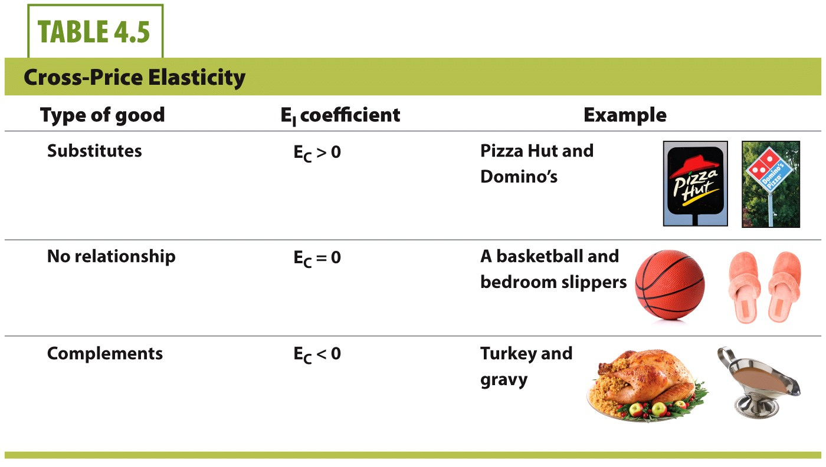

Slide 41
Price Elasticity of Supply
Price elasticity of supply mathematically
Quantity supplied change as a result of a change in price
Will this ratio be positive or negative? Why?
Price elasticity of supply is positive because of the direct relationship between price and quantity supplied.
Notes:
Once again, the equation has a familiar look to it. The denominator is the same as the demand elasticity formula (we are looking at a price change), but the numerator is different. Here, we are examining the resulting change in quantity supplied.

Slide 42
Price Elasticity of Supply Determinants
Flexibility of producers
More production flexibility implies more elastic supply.
Firms will be very responsive to changes in price.
A firm will have more production flexibility if it is able to:
Have extra capacity
Maintain inventory
Relocate easily
Notes:
Lecture notes:
Example of elastic supply:
De Beers diamonds has raw, uncut diamonds in inventory that aren't put on the market yet.
If the price goes up, it is very easy to put these diamonds for sale.
Hotdog vendors can adapt easily to changes in demand
It is easy to relocate to a higher-demand area (where price is higher).
Examples of inelastic supply:
Sporting events
It is not easy to add more stadiums (or even more seats within an existing stadium) if the price goes up.
Fresh fish at the dock
What is available today is what was caught today; this cannot change easily.

Slide 43
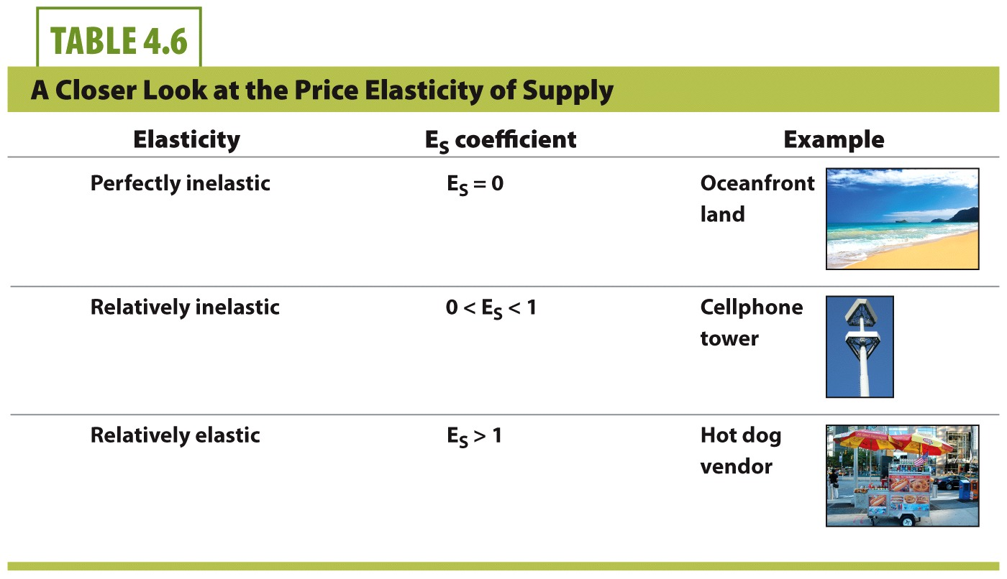

Slide 44
Price Elasticity of Supply Determinants
Time and adjustment process
Immediate run
Suppliers are stuck with what they have on hand; no adjustment.
Short run, long run
The more time that passes, the more the firm is able to adjust to market conditions.
Supply becomes more elastic over time.
Notes:
Analogous to demand. Supply becomes more responsive in the long run when there is more time to adjust to changing market conditions.

Slide 45
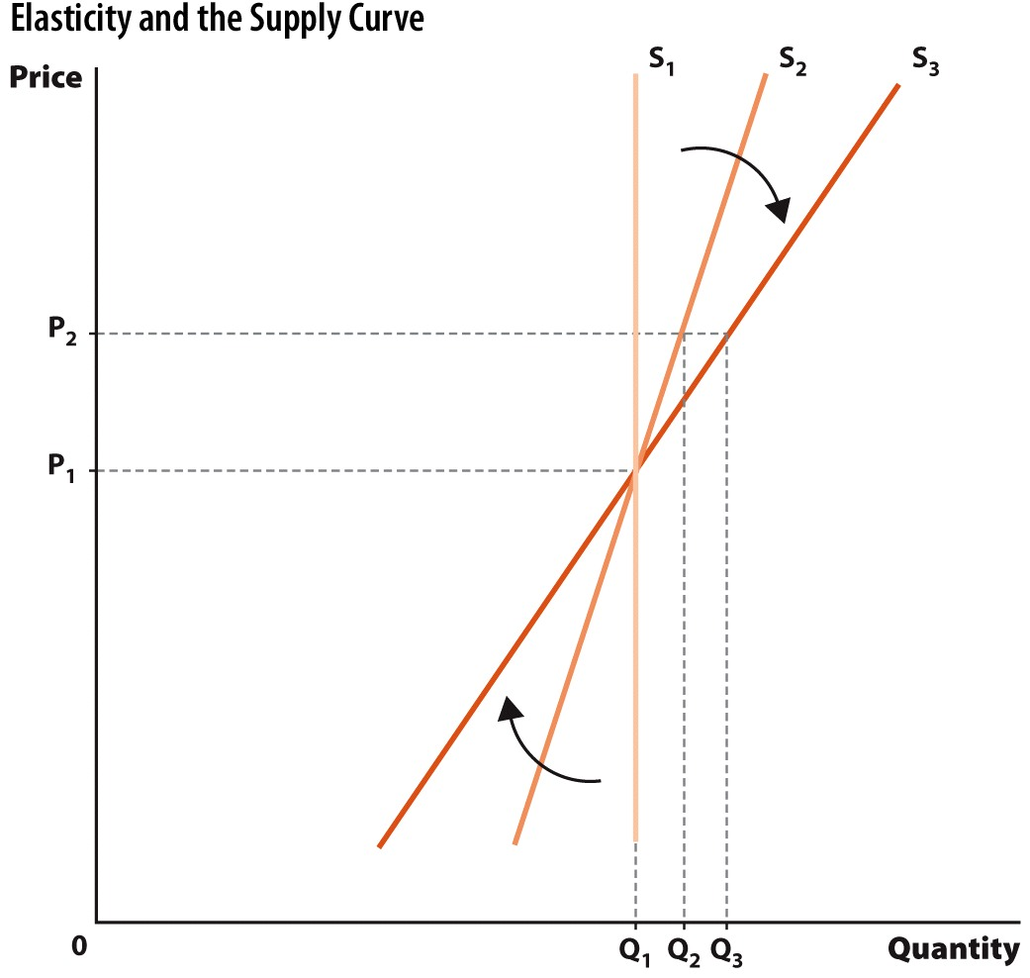
Notes:
Increased flexibility and more time make supply more elastic. When price rises from P₁ to P₂, producers are unable to expand output immediately and the supply curve remains at Q₁. In the short run (S₂), the firm becomes more flexible and output expands to Q₂. Eventually, in the long run (S₃), the firm is able to produce even more, and it moves to Q₃ in response to higher prices.

Slide 46
Combining Supply and Demand
We've previously drawn shifts in demand and supply, and studied the changes in equilibrium price and quantity.
How will the magnitude of the price and quantity change be affected if we change the demand or supply elasticity?

Slide 47
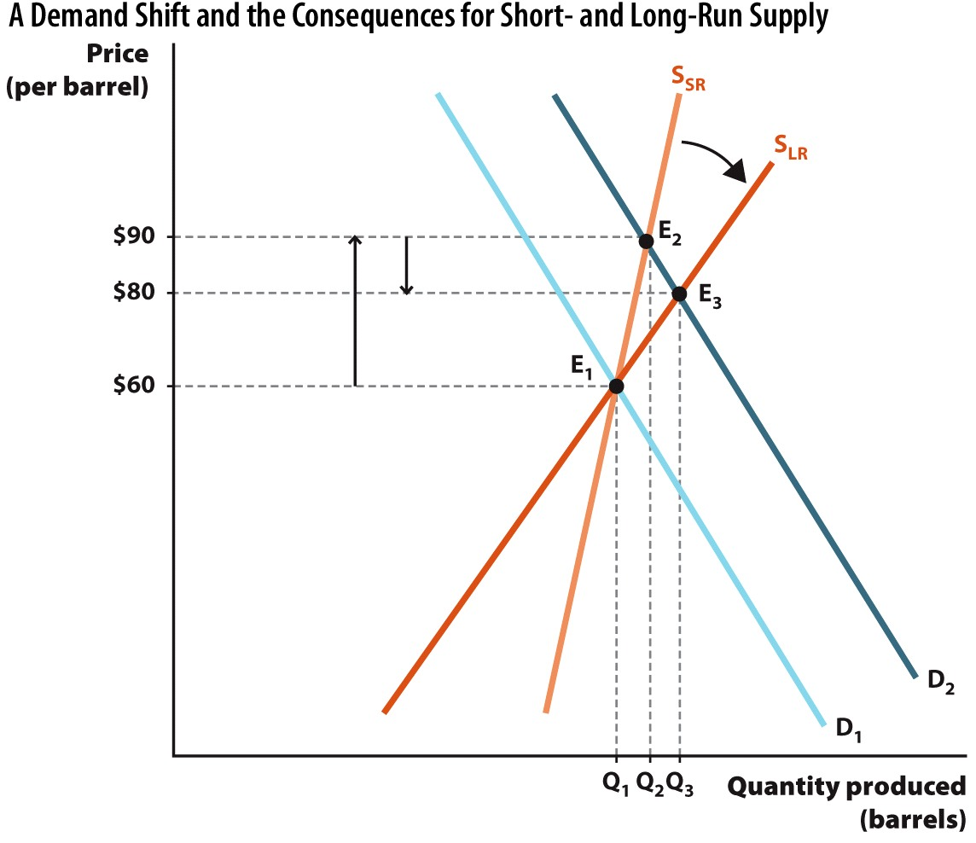
Notes:
When an increase in demand causes the price of oil to rise from $60 to $90 per barrel, initially producers are unable to expand output very much—production expands from Q₁ to Q₂. However, in the long run, as producers expand production, the price will fall back to $80.

Slide 48
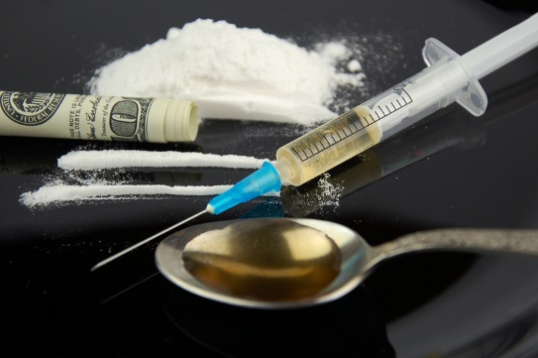
Case Study: Drug Elasticity and Revenues
Think about the demand for illegal drugs. Do you think the demand is relatively elastic or inelastic. Why?
Relatively inelastic
No substitutes
May make up a small percent of income.
Addiction may increase willingness to pay.

Slide 49
Drug Elasticity and Revenues
Suppose that we wanted to enact a policy with the following goals:
Greatly decrease drug consumption.
Make drug-dealing a less attractive business.
Reaching the goals:
Should we try to decrease the supply of drugs or decrease the demand for drugs?

Slide 50
Drug Elasticity and Revenues
Decrease the supply of drugs
Tougher laws for drug dealers
More police enforcement
Decrease the demand for drugs
Drug education programs
Offer (legal) substitute activities to decrease drug demand
Notes:
Decreasing the supply of drugs means going after the dealers.
Decreasing the demand for drugs means trying to make people want to consume less drugs. Drug education programs will hopefully make people more aware of the dangers of drug use.

Slide 51
Drug Elasticity and Revenues
Draw a supply curve with a relatively inelastic demand. Draw this graph twice.
What happens if there is a leftward shift in supply?
Quantity only slightly decreases.
The new equilibrium is at a higher point on the demand curve. Since demand is inelastic, this means that total drug revenues actually increase!

Slide 52
Drug Elasticity and Revenues
P
S₂
Leftward shift in supply:
Only a small decrease in drug transactions.
Increase in drug prices.
Increase in drug revenues.
This may actually make drug-dealing more lucrative (and dangerous).
S₁
P₂
E₂
P₁
E₁
D
Q₂
Q₁
Q
Notes:
The purple area is an overlap of red and blue. Blue by itself represents lost drug revenue from the supply shift. Red by itself represents gain in drug revenue. Note that the gain outweighs the loss, so overall drug revenue actually increases. This could make drug-dealing more profitable.

Slide 53
Drug Elasticity and Revenues
What happens if there is a leftward shift in demand?
Quantity decreases more than the previous case.
Drug revenues decrease.

Slide 54
Drug Elasticity and Revenues
Leftward shift in demand:
Larger decrease in drug transactions.
Decrease in drug prices.
Decrease in drug revenues.
Drug dealing is now less attractive.
P
S
P₁
E₁
P₂
E₂
D₂
D₁
Q₂
Q₁
Q
Notes:
In this case, overall drug revenue decreases since price and quantity fall. This leftward demand shift makes drug-dealing less attractive.

Slide 55
Drug Elasticity and Revenues
Thus, it appears that if we want to accomplish our two goals . . .
Policy of decreasing drug demand will be better than trying to decrease drug supply.
Better to use resources on education and offering legal substitutes rather than increasing penalties and police enforcement.

Slide 56
Conclusion
Elasticity is a measure of sensitivity (responsiveness) between two variables.
The ability to determine whether demand and supply are elastic or inelastic allows economists to calculate the effects of personal, business, and policy decisions.
Understanding elasticity helps our economic model say much more about the world.

Slide 57
Summary
The price elasticity of demand
A measure of the responsiveness of quantity demanded to a change in price.
Demand will generally be more elastic if:
There are many substitutes available.
The item comprises a large share of your budget.
You have plenty of time to make a decision.

Slide 58
Summary
Elasticity and slope are not the same.
Total revenue can be calculated by taking the price of the good and multiplying it by the quantity sold.
If demand is inelastic
Total revenue will rise as the price rises.
If demand is elastic
Total revenue will rise as the price falls.

Slide 59
Summary
The price elasticity of supply
A measure of the responsiveness of the quantity supplied to a change in price.
Supply will generally be more elastic if producers have:
Flexibility in the production process.
Ample time to adjust production.

Slide 60
Summary
The income elasticity of demand:
The change in the quantity purchased divided by the change in personal income.
Normal goods have a positive income elasticity.
Inferior goods have a negative income elasticity.
The cross-price elasticity of demand:
Responsiveness of the quantity demanded of one good to a change in the price of another good.
Positive values for the cross-price elasticity mean that two goods are substitutes.
Negative values indicate that the two goods are complements.

Slide 61
Practice What You Know
Suppose that the price of candy bars increases by 100%. As a result of this, you decide to purchase 50% less candy bars. How would you describe your demand for candy bars?
Demand is elastic.
Demand is unit elastic.
Demand is inelastic.
Demand is perfectly inelastic.
Notes:
Correct answer: C
Price is "less important" than quantity. Mathematically, the numerator (%QD change) is less than the denominator (%Price change), so the magnitude is smaller than 1. This is inelastic; relatively insensitive.

Slide 62
Practice What You Know
Suppose that Doug receives a pay increase at work, and his income increases by 20%. As a result, Doug decides to buy 12% less ground beef. For Doug, ground beef is a(n) ________.
luxury good
necessity good
normal good
inferior good
Notes:
Correct answer: D
MORE income leads to LESS consumption. This is a characteristic of an inferior good.

Slide 63
Practice What You Know
Economists have studied that when the price of chicken increases, people purchase less rice. With these two goods, which of the following is true? (E_{C} = Cross-price elasticity)
E_{C} < 0, chicken and rice are complements.
E_{C} > 0, chicken and rice are complements.
E_{C} < 0, chicken and rice are substitutes.
E_{C} > 0, chicken and rice are substitutes.
Notes:
Correct answer: A
E_{C} < 0 (key words are INCREASE in chicken price, purchase LESS rice).

Slide 64
Practice What You Know
In terms of price elasticity of demand, which of the following goods do you think is the least elastic (most inelastic)?
New house
Electricity to power your home
A specific brand of breakfast cereal
New vehicle
Notes:
Correct answer: B
Houses and vehicles are elastic since the make up a big portion of your budget.
A specific type of cereal is elastic since it has a lot of substitutes.
Electricity has no viable substitutes.

Slide 65
Practice What You Know
Suppose a firm is selling a product at a price on the inelastic portion of the demand line. This firm could increase revenue by doing what?
Lowering the price, selling more units
Lowering the price, selling less units
Increasing the price, selling more units
Increasing the price, selling less units
Notes:
Correct answer: D
Why is (c) not correct? The demand curve is downward-sloping. We can't increase the price and sell more, or we would be picking a point that isn't even on the demand line.
By increasing the price and selling less units, we are moving toward the unit elastic point in which revenue is maximized.

Slide 66
Sources
"Principles of Economics with Smartwork Access (ISBN: 978-0-26314-5), 1st Edition, 2013" by Mateer and Coppock
"Economics: Custom Edition for NCSU (ISBN: 9781937435202" by David Hyman

